Slide 1
Layer 2.5 NC
Jarrett Gaddy

Slide 2
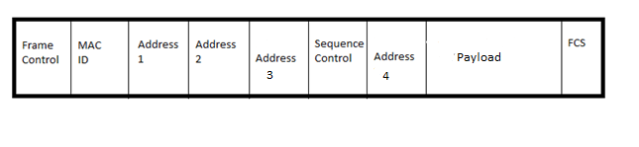
MAC Frame
A layer 2 MAC frame contains the following in order:
2 bytes of Frame Control information
2 bytes for Duration and ID number
6 bytes for Address 1
6 bytes for Address 2
6 bytes for Address 3
2 bytes for sequence control
6 bytes for Address 4
0 to 2312 bytes for Payload
4 bytes for frame check sequence

Slide 3
LLC Header
The logical link control header contains the following values in order for a coded frame:
1 byte for Source Service Access Point SSAP containing 0xAA
1 byte for Destination Service Access Point DSAP containing 0xAA
1 or 2 bytes for Control field (still working on understanding this field. uses high-level data link control specification) should contain 1 byte 0x03
3 bytes for OUI containing 0xAAAAAA
2 bytes for Protocol ID containing 0xAAAA
0 to 2304 bytes for layer 2.5 payload

Slide 4
Layer 2.5 NC Header
2 Versions of header:
To AP:
  2 bytes for the sequence number being acked.
From AP:
  2 bytes for SEQ number of frame 1.
  2 bytes for SEQ number of frame 2.
  4 bytes ip adr of dest 1.
  4 bytes ip adr of dest 2.

Slide 5
Encapsulation
For layer 2.5 network coding we begin with a layer 3 datagram.
This datagram is encapsulated within a layer 2.5 NC header.
Then encapsulated within the LLC Header with values indicating network coding.
Then encapsulated in MAC header.
Finally the MAC frame is sent over 802.11 phy.

Slide 6
Acknowledgment system
All data frames on 802.11 must be acknowledged.
Responsibility of client to ack on decoding of a network coded frame.
Can’t use 802.11 MAC ack.
Client fits ack in to the header for the next frame it sends to AP.
AP will not use NC to send to a client that has an un-acked frame.

Slide 7
Client Operation

Slide 8
Access Point Operation

